Slide 1

Tableau Project FIFA2018 Player Ratings Analysis by
Jasper Umoffia

Slide 2
Our Aim
Analyze the player distribution used in the game
Analyze the player ratings vs wages earned
Suggest best leagues for young talents to play to earn higher wages

Slide 3
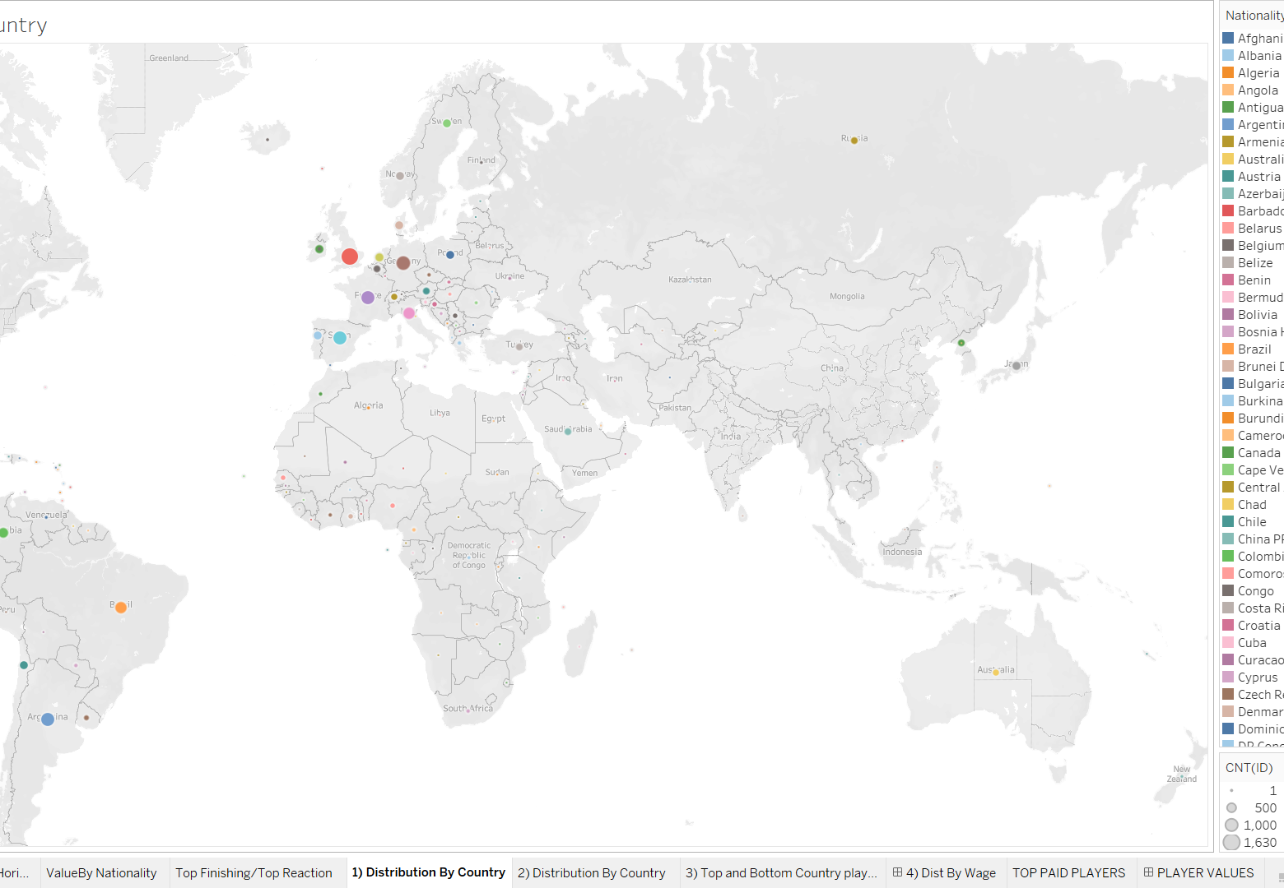
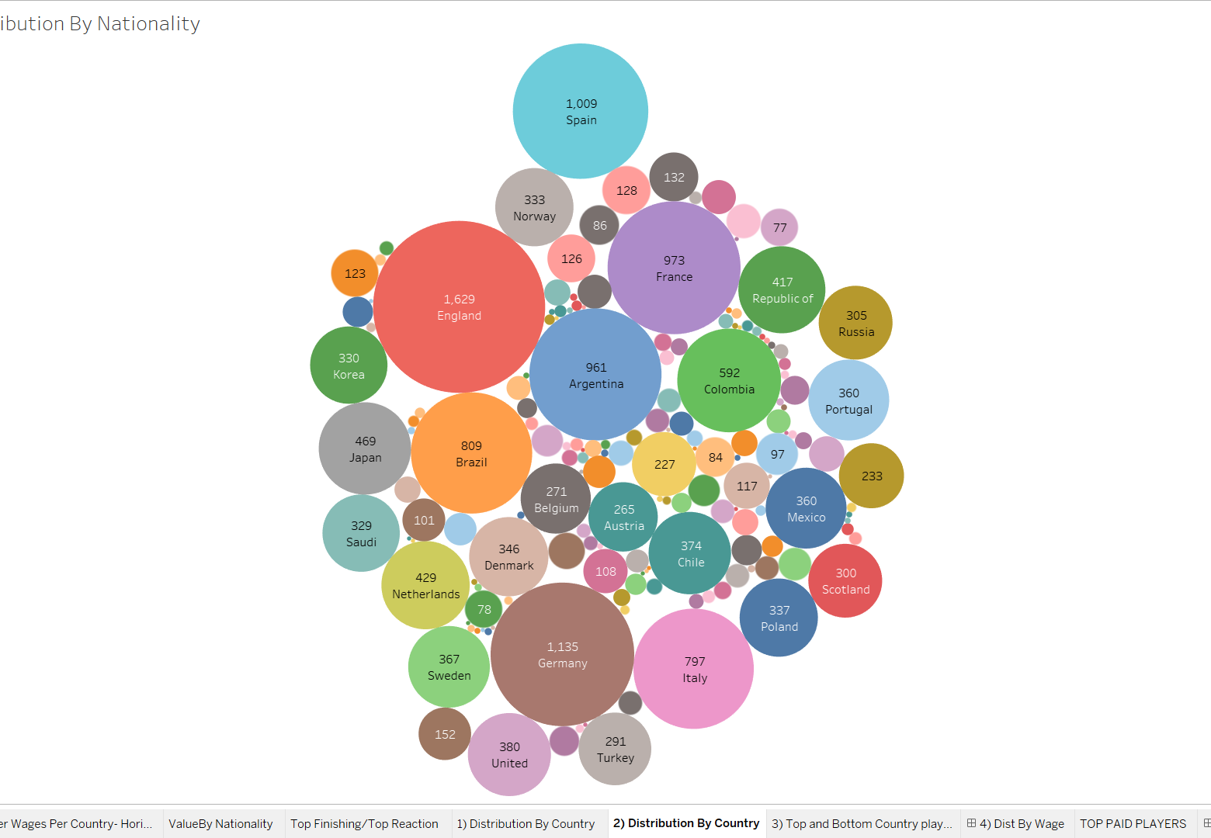
Distribution by nationality

Slide 4
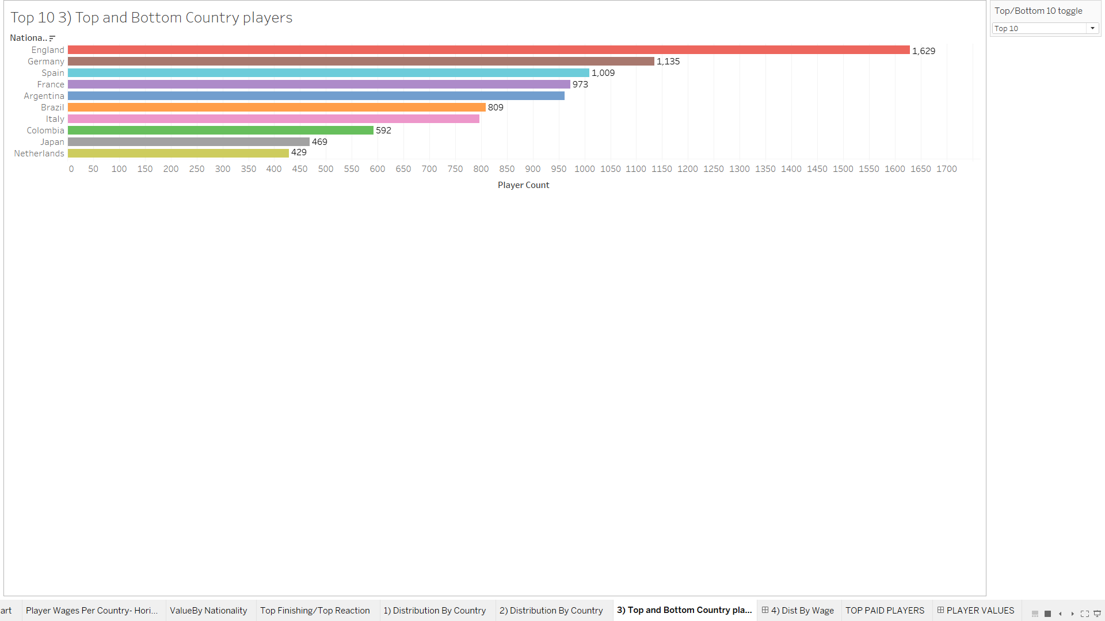
Top 10 FIFA18 Player Countries

Slide 5
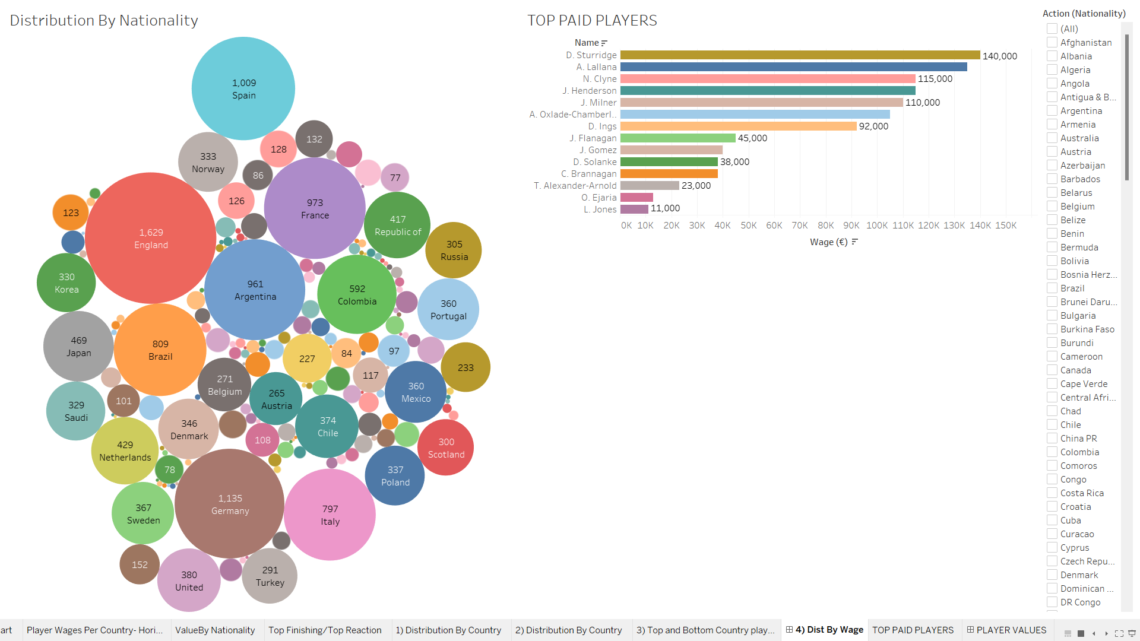
Wages for England

Slide 6
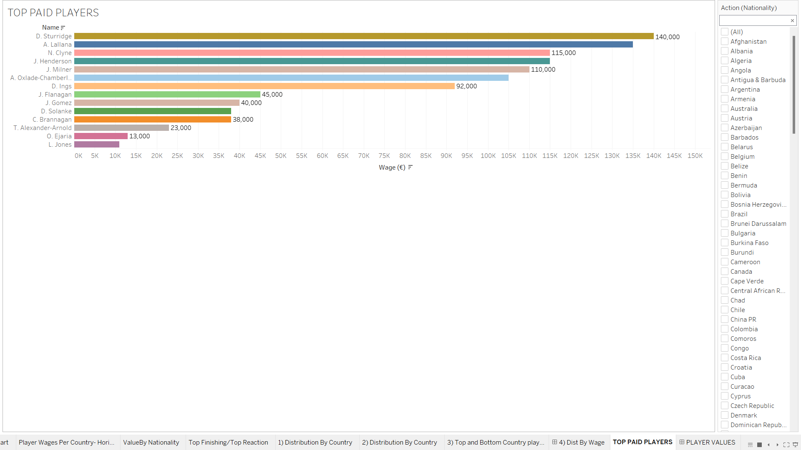
Sturridge is highest paid English player with 140,000

Slide 7
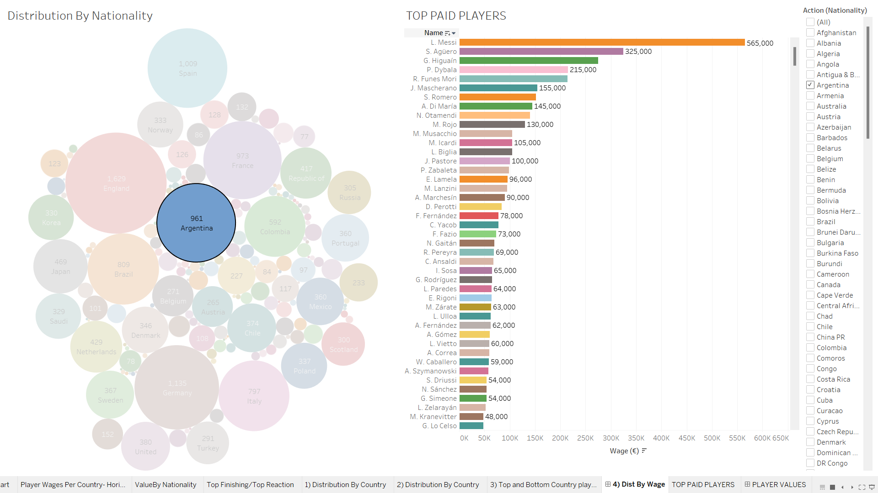
Wages for Argentina

Slide 8
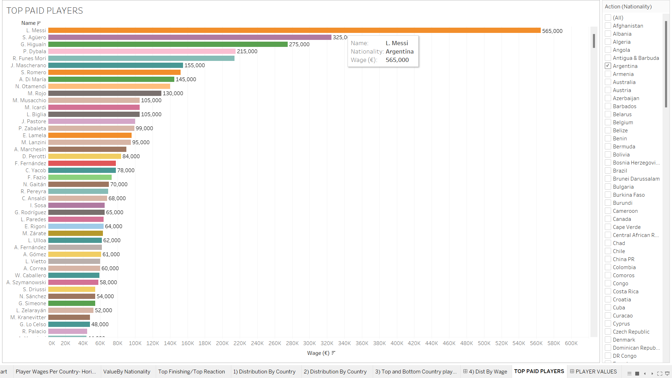

Slide 9
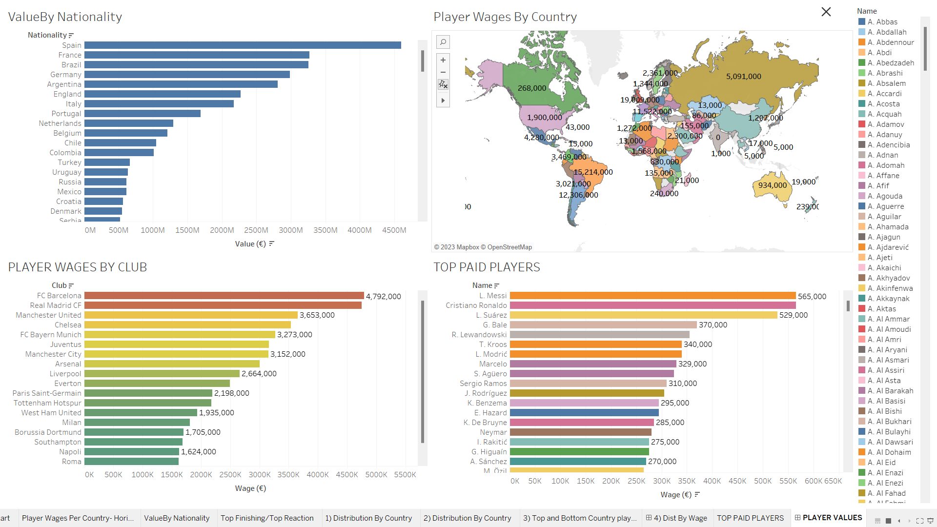
FIFA18 Quality Vs Quantity

Slide 10
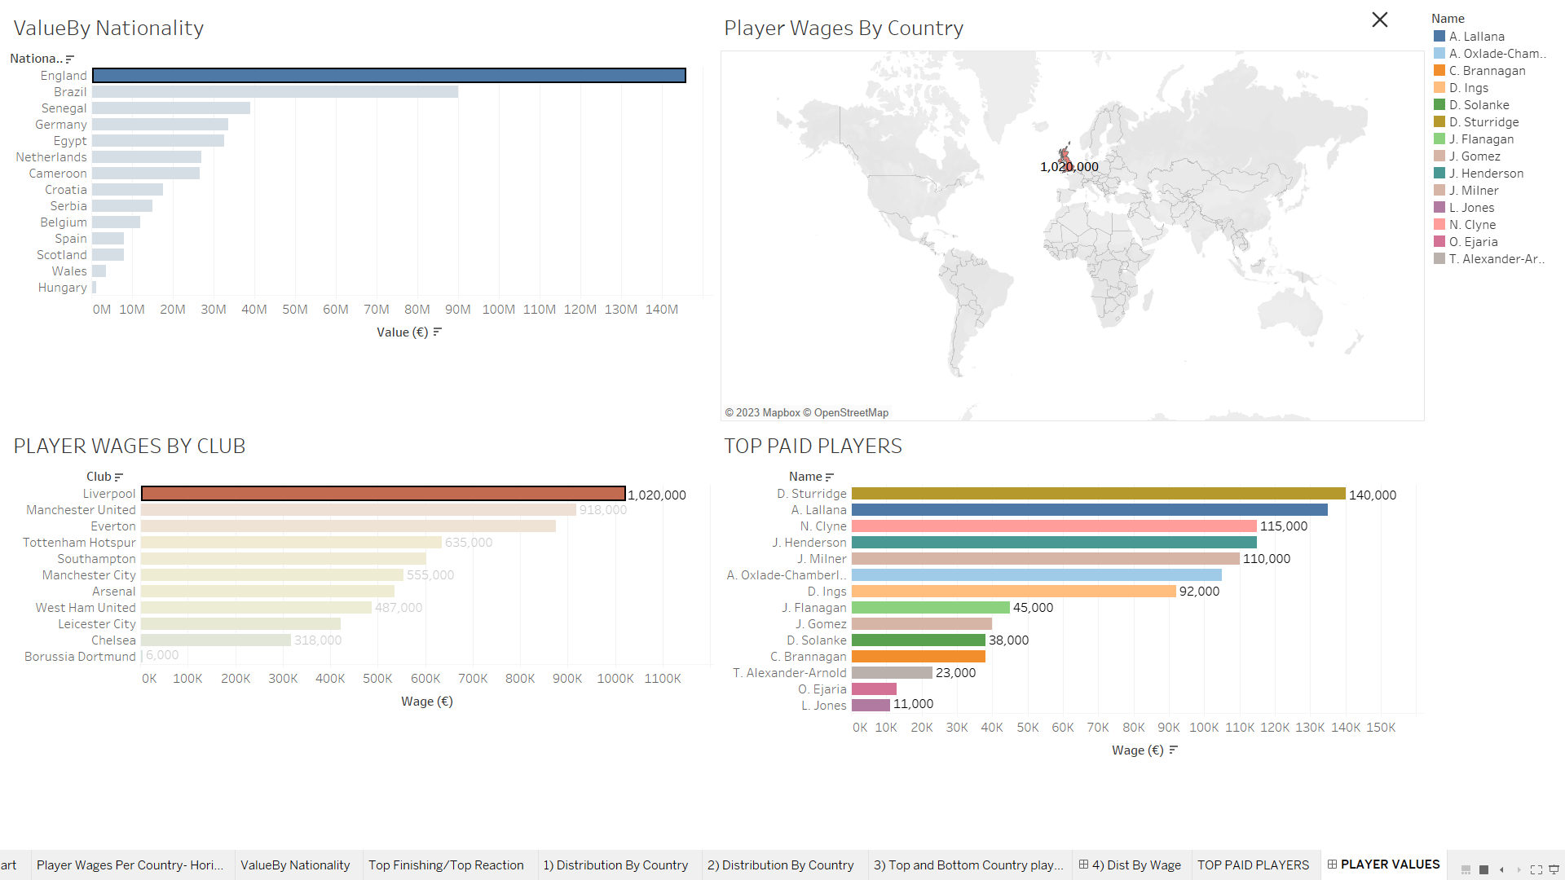
COMPARISONS(Player Values)

Slide 11
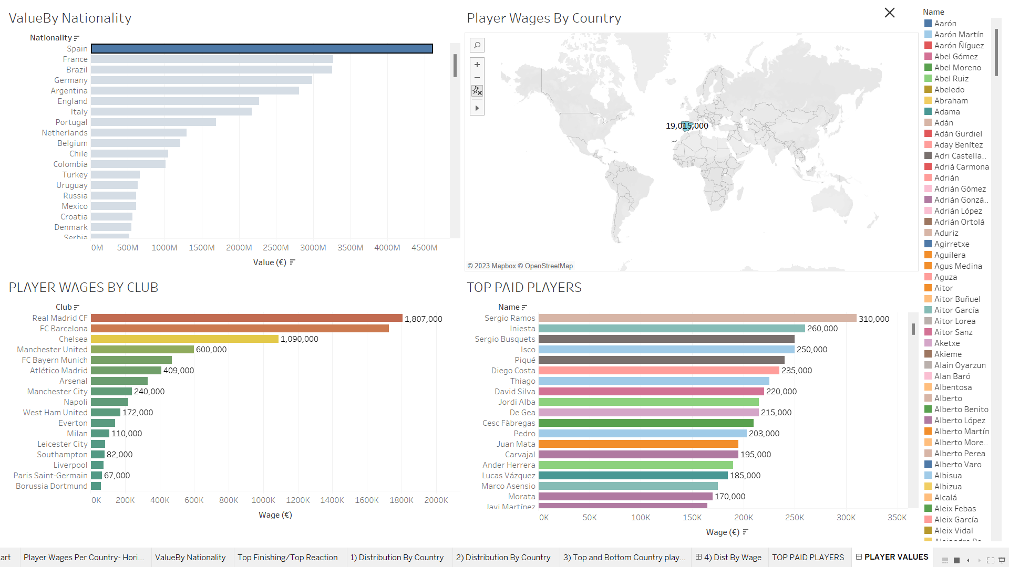
Player Values

Slide 12

Questions!!!!!!

